Slide 1
Introduction to AI
‹#›
Notes:
‹#›

Slide 2
What is AI?
an attempt of
AI is the reproduction of human reasoning and intelligent behavior by computational methods
Intelligent
behavior
Computer
Humans
‹#›
Notes:
‹#›

Slide 3
What is artificial intelligence?
It is the science and engineering of making intelligent machines, especially intelligent computer programs. It is related to the similar task of using computers to understand human intelligence, but AI does not have to confine itself to methods that are biologically observable.
Yes, but what is intelligence?
Intelligence is the computational part of the ability to achieve goals in the world. Varying kinds and degrees of intelligence occur in people, many animals and some machines.
‹#›

Slide 4
What’s involved in Intelligence?
Ability to interact with the real world
to perceive, understand, and act
e.g., speech recognition and understanding and synthesis
e.g., image understanding
e.g., ability to take actions, have an effect
Reasoning and Planning
modeling the external world, given input
solving new problems, planning, and making decisions
ability to deal with unexpected problems, uncertainties
Learning and Adaptation
we are continuously learning and adapting
our internal models are always being “updated”
e.g., a baby learning to categorize and recognize animals
‹#›

Slide 5
What is AI? (R&N)
Discipline that systematizes and automates reasoning processes to create machines that:
Act like humans | Act rationally
Think like humans | Think rationally
‹#›
Notes:
‹#›

Slide 6
Act like humans | Act rationally
Think like humans | Think rationally
The goal of AI is to create computer systems that perform tasks regarded as requiring intelligence when done by humans
🡪 AI Methodology: Take a task at which people are better, e.g.:
Prove a theorem
Play chess
Plan a surgical operation
Diagnose a disease
Navigate in a building
and build a computer system that does it automatically
But do we want to duplicate human imperfections?
‹#›
Notes:
‹#›

Slide 7
Act like humans | Act rationally
Think like humans | Think rationally
Here, how the computer performs tasks does matter
The reasoning steps are important
🡪 Ability to create and manipulate symbolic knowledge (definitions, concepts, theorems, …)
What is the impact of hardware on low-level reasoning, e.g., to go from signals to symbols?
‹#›
Notes:
‹#›

Slide 8
Act like humans | Act rationally
Think like humans | Think rationally
Now, the goal is to build agents that always make the “best” decision given what is available (knowledge, time, resources)
“Best” means maximizing the expected value of a utility function
🡪 Connections to economics and control theory
What is the impact of self-consciousness, emotions, desires, love for music, fear of dying, etc ... on human intelligence?
‹#›
Notes:
‹#›

Slide 9
Can Machines Act/Think Intelligently?
“If there were machines which bore a resemblance to our bodies and imitated our actions as closely as possible for all practical purposes, we should still have two very certain means of recognizing that they were not real men. The first is that they could never use words, or put together signs, as we do in order to declare our thoughts to others… Secondly, even though some machines might do some things as well as we do them, or perhaps even better, they would inevitably fail in others, which would reveal that they are acting not from understanding, …”
Discourse on the Method, by Descartes (1598-1650)
‹#›
Notes:
‹#›

Slide 10
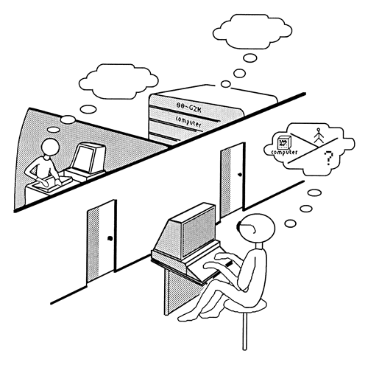
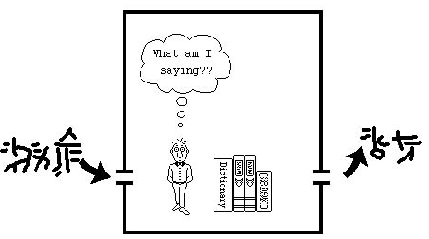
Can Machines Act/Think Intelligently?
Turing Test:
http://plato.stanford.edu/entries/turing-test/
Test proposed by Alan Turing in 1950
The computer is asked questions by a human interrogator. It passes the test if the interrogator cannot tell whether the responses come from a person
Required capabilities: natural language processing, knowledge representation, automated reasoning, learning,...
No physical interaction
Chinese Room (J. Searle)
‹#›
Notes:
‹#›

Slide 11
An Application of the Turing Test
CAPTCHA: Completely Automatic Public Turing tests to tell Computers and Humans Apart
E.g.:
Display visually distorted words
Ask user to recognize these words
Example of application: have only humans open email accounts
‹#›
Notes:
‹#›

Slide 12
Can Machines Act/Think Intelligently?
Yes, if intelligence is narrowly defined as information processing AI has made impressive achievements showing that tasks initially assumed to require intelligence can be automated
Maybe yes, maybe not, if intelligence is not separated from the rest of “being human”
‹#›
Notes:
‹#›

Slide 13
Intelligence:
“the capacity to learn and solve problems”
in particular,
the ability to solve novel problems
the ability to act rationally
the ability to act like humans
Artificial Intelligence
build and understand intelligent entities or agents
2 main approaches: “engineering” versus “cognitive modeling”
‹#›

Slide 14
Academic Disciplines relevant to AI
Philosophy Logic, methods of reasoning, mind as physical system, foundations of learning, language, rationality.
Mathematics Formal representation and proof, algorithms, computation, (un)decidability, (in)tractability
Probability/Statistics modeling uncertainty, learning from data
Economics utility, decision theory, rational economic agents
Neuroscience neurons as information processing units.
Psychology/ how do people behave, perceive, process cognitive
Cognitive Science information, represent knowledge.
Computer building fast computers engineering
Control theory design systems that maximize an objective function over time
Linguistics knowledge representation, grammars
‹#›

Slide 15
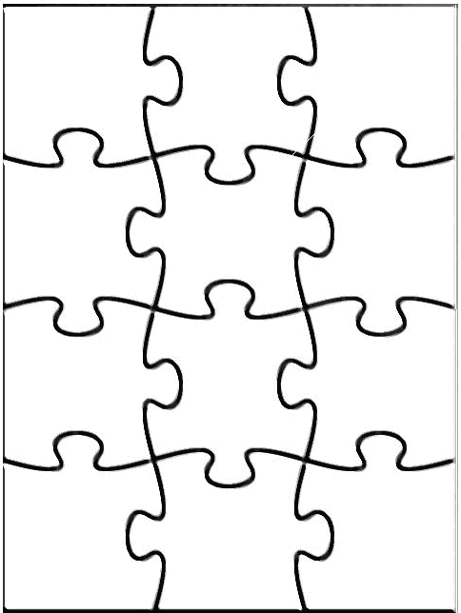
Main Areas of AI
Knowledge representation (including formal logic)
Search, especially heuristic search (puzzles, games)
Planning
Reasoning under uncertainty, including probabilistic reasoning
Learning
Agent architectures
Robotics and perception
Natural language processing
Agent
Perception
Robotics
Reasoning
Search
Learning
Knowledge rep.
Constraint satisfaction
Planning
Natural language
...
Expert
Systems
‹#›
Notes:
‹#›

Slide 16
History of AI
1943: early beginnings
McCulloch & Pitts: Boolean circuit model of brain
1950: Turing
Turing's "Computing Machinery and Intelligence“
1956: birth of AI
Dartmouth meeting: "Artificial Intelligence“ name adopted
1950s: initial promise
Early AI programs, including
Samuel's checkers program
Newell & Simon's Logic Theorist
1955-65: “great enthusiasm”
Newell and Simon: GPS, general problem solver
Gelertner: Geometry Theorem Prover
McCarthy: invention of LISP

Slide 17
History of AI
1966—73: Reality dawns
Realization that many AI problems are intractable
Limitations of existing neural network methods identified
Neural network research almost disappears
1969—85: Adding domain knowledge
Development of knowledge-based systems
Success of rule-based expert systems,
E.g., DENDRAL, MYCIN
But were brittle and did not scale well in practice
1986-- Rise of machine learning
Neural networks return to popularity
Major advances in machine learning algorithms and applications
1990-- Role of uncertainty
Bayesian networks as a knowledge representation framework
1995-- AI as Science
Integration of learning, reasoning, knowledge representation
AI methods used in vision, language, data mining, etc

Slide 18
Components of AI program
Artificial Intelligence has following components –
Learning
Reasoning
Problem solving
Perception
Language understanding
‹#›

Slide 19
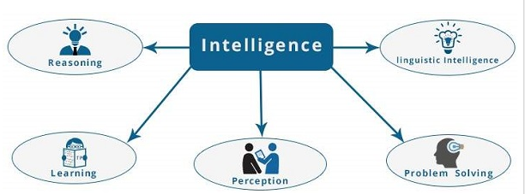
Components of AI program
‹#›

Slide 20
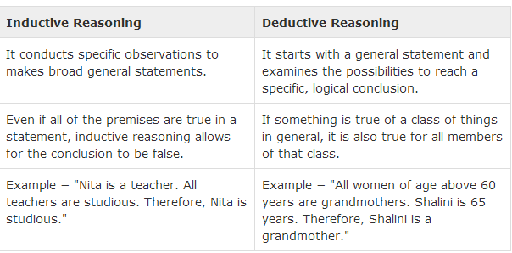
Reasoning − It is the set of processes that enables us to provide basis for judgement, making decisions, and prediction. There are broadly two types
‹#›

